Slide 1


Slide 2
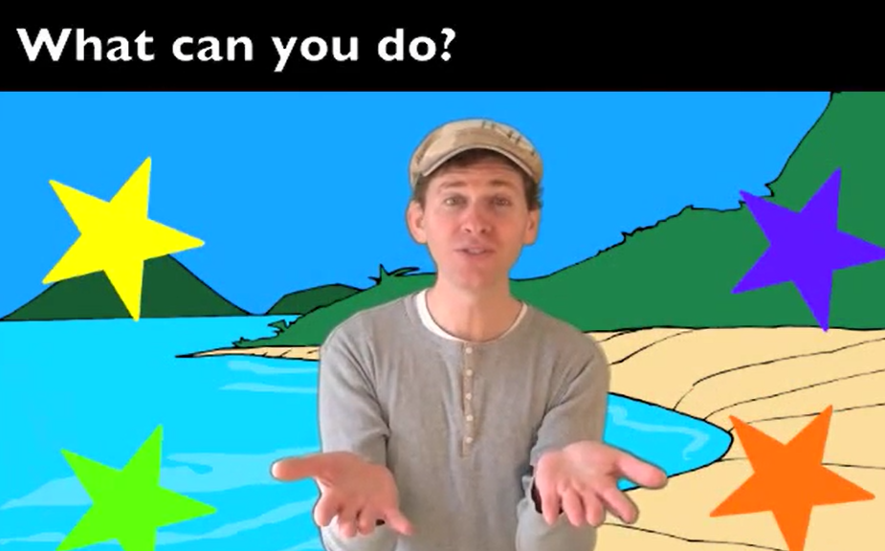
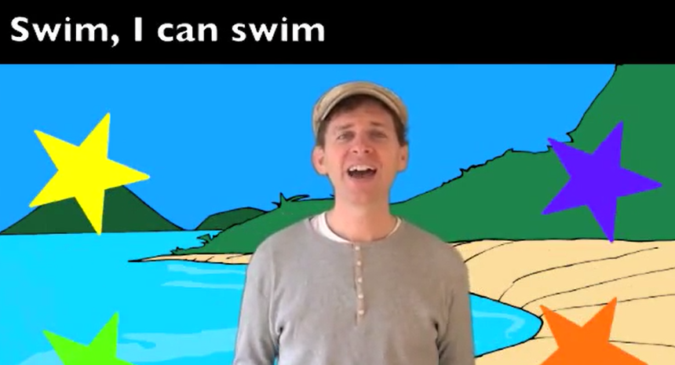

Slide 3

Unit 5
Can you swim?
Lesson 1

Slide 4

Game
Missing leters

Slide 5
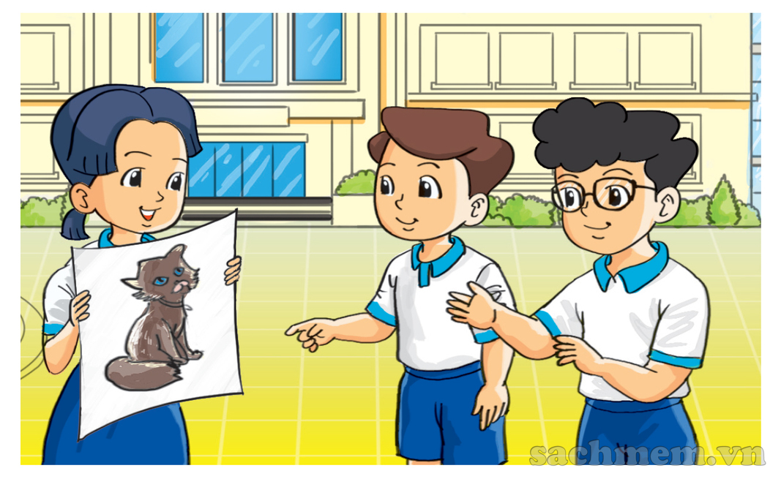
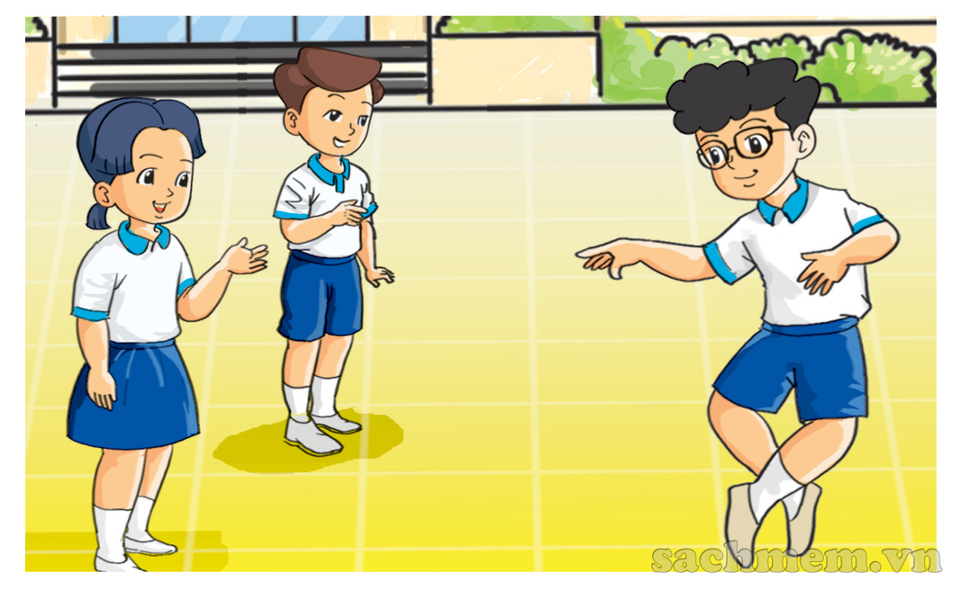
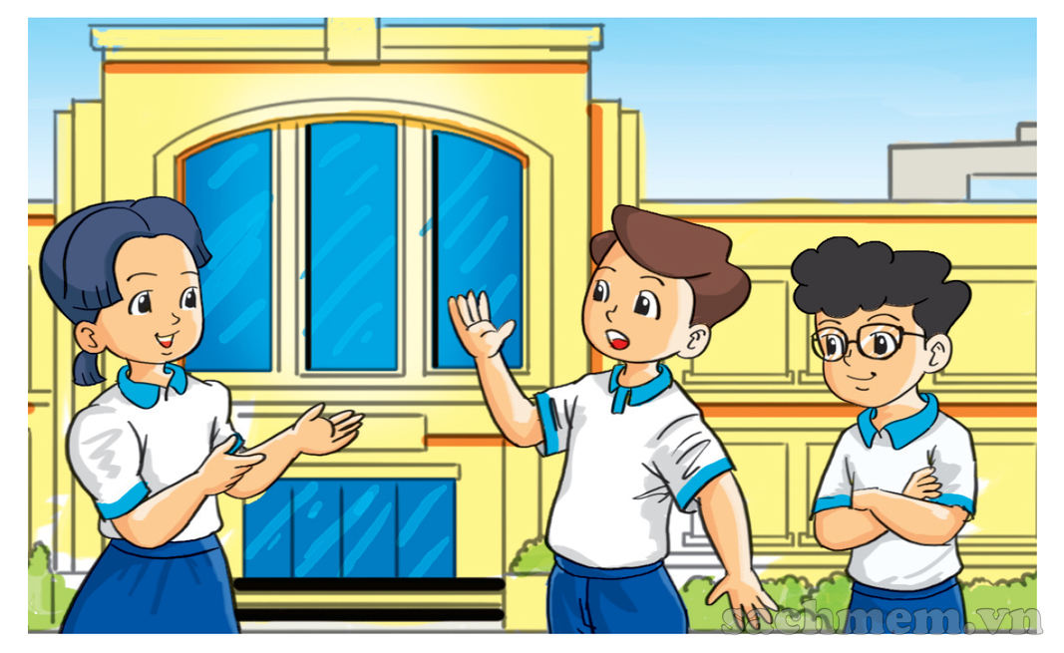
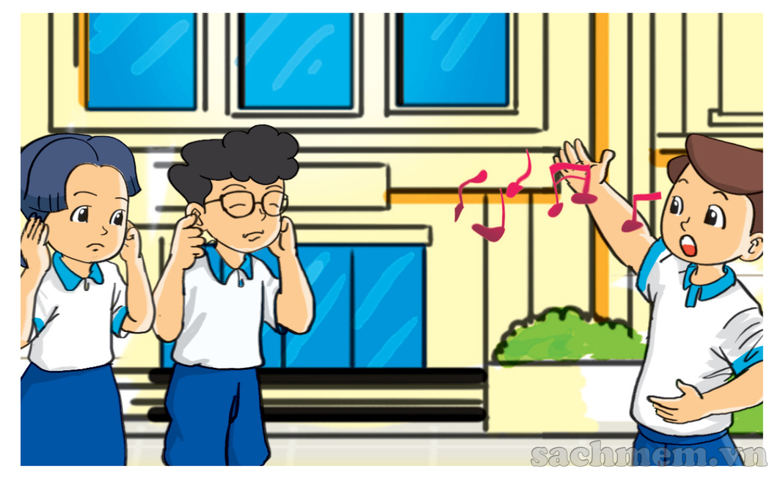
a
b
c
d

Slide 6

a
Look, I can draw a cat.
b
What can you do, Phong?
I can dance.
It’s really nice.
c
What about you, Nam?
d
Me? I can’t dance,
but I can sing.

Slide 7
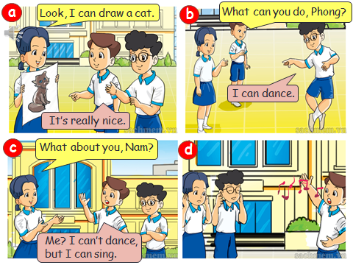
1. Mai can draw a cat or a dog?
3. Can Nam sing?
2. Phong can sing or can dance?
4. In picture d, What does Nam ask?
What does Phong answer?

Slide 8
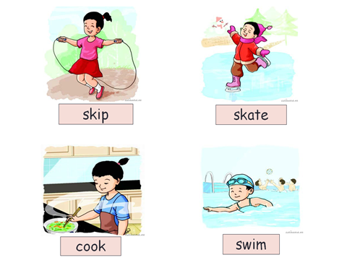
2. Point and say.
What can you do?
I can ______.
a
b
c
d

Slide 9
Game
Lucky number

Slide 10



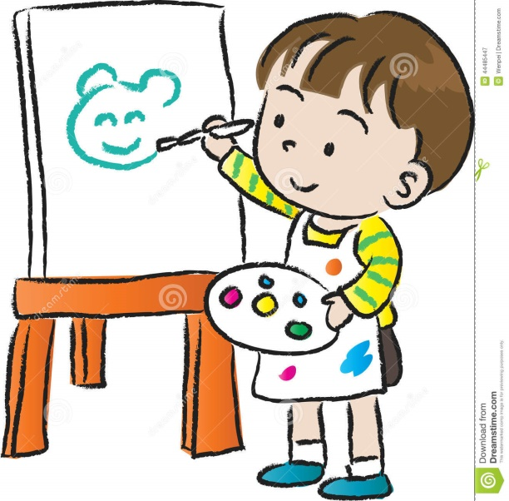
What can you do?
I can ______.
a
b
c
d

Slide 11

The end
Thanks for enjoying !!!

